Slide 1
Neural Style Implementation

Slide 2
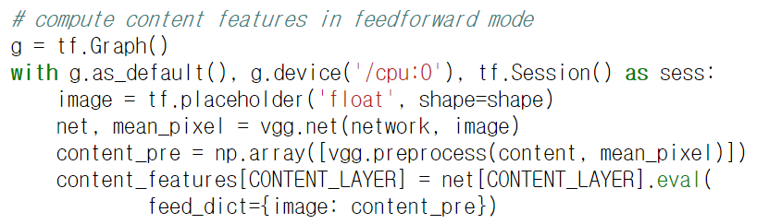
Content part

Slide 3
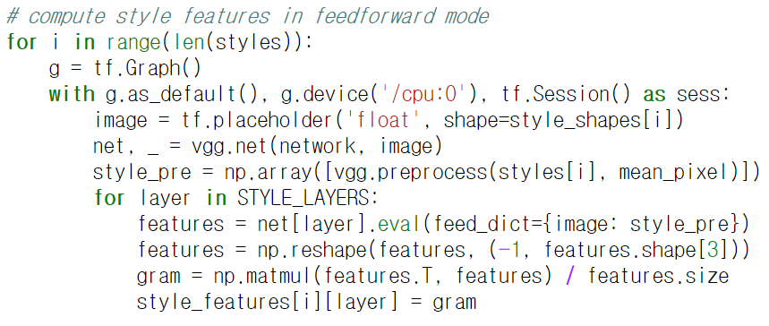
Style part
usually one
vectorize
gram matrix

Slide 4
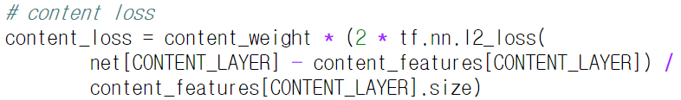
Content loss

Slide 5
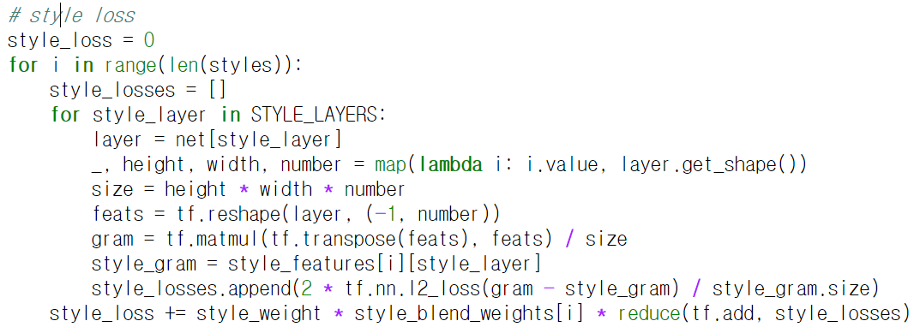
Style loss

Slide 6
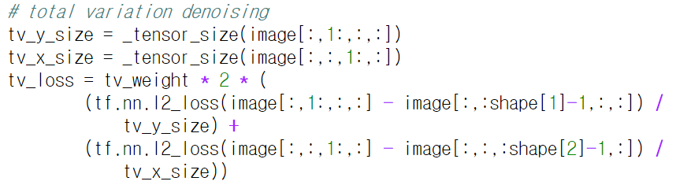
Regulator

Slide 7
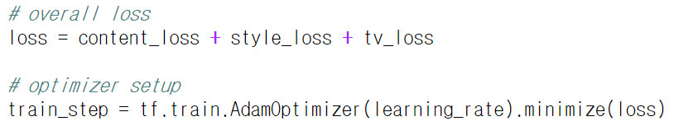
Total loss

Slide 8
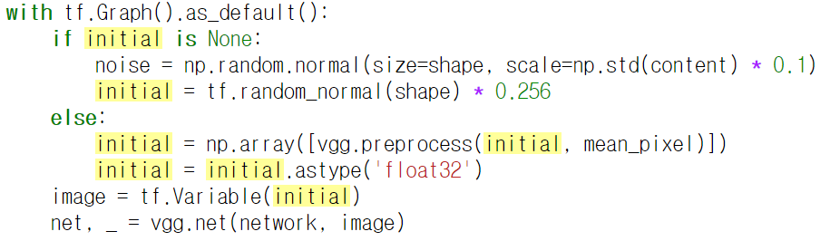
Initialization

